Slide 1
youth sports & swim Technology platform
© 2019 YMCA of the USA
Notes:
John to Welcome

Slide 2
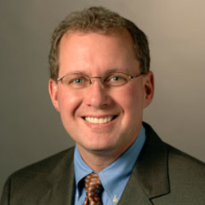
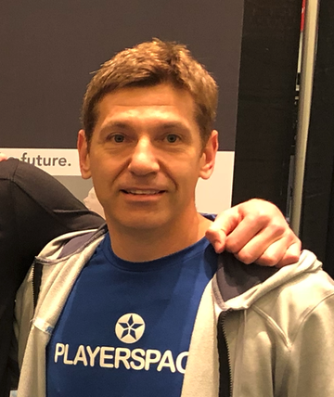
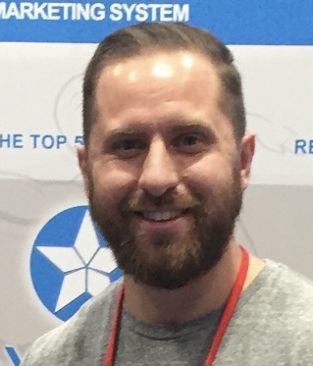
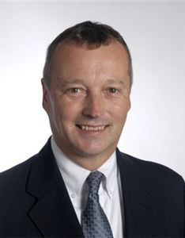
Introductions
Kevin Lutz
SVP and CIO
YMCA OF THE USA
Lindsay Mondick
Senior Manager, Aquatics
YMCA OF THE USA
Todd John
President and Founder
PlayerSpace
Shawn Borzelleri
Sr. VP, Service
Delivery and
Program Innovation
YMCA OF THE USA
Chris Capone
VP Customer Operations
PlayerSpace
Heidi Brasher
Sr. Director, Product
Line Cohorts, Strategy
and Innovation
YMCA OF THE USA
John Atwater
Sr. Director Y-Movement Solutions and Services
YMCA OF THE USA

Slide 3
AGENDA
YMCA and Playerspace
Background
Goals and Benefits
2. the platform
Youth Sports
Youth Swim
Camp
Mobile
Benefits
3. National portal & Demo
4. Program data upload for all Ys
5. QUESTIONS
Notes:
John to Cover and Introduce: Lindsay, Ben, Luis, TJ, Kevin Lutz

Slide 4
Ymca and playerspace
Background
Any Y can Upload their Program Offerings to ymcasports.org for Prospective Participant Search
December 2016 Agreement
Standardized/Reduced Price to $1 per Participant
Provided framework for ymcasports.org website
Since 2016 PLAYERSPACE has:
Expanded to 140 Ys and 3M Participants & Caregivers
Added Swim, Camps, and Gymnastics Applications
Integrated with BIB to Perform Background Checks on Volunteers

Slide 5
Ymca and playerspace
Goals and Benefits
www.ymcasports.org
One Place to Find all YMCA Programs in all Communities
Direct Revenue to Ys
Platform for Nationwide Stories, Photos and Videos Promoting Program Quality and the Y Brand
Opportunity to combine buying power for Keywords
Opportunity for Sponsor Revenue

Slide 6
the platform
The largest and fastest growing YMCA program management system in the U.S.
-Est. circa 2006
-Integrate with 6 Member Management Systems
-140 Y’s
-3million participants, volunteer coaches and caregivers
Solutions
-League & Tournaments
-Swim Lessons, Tests, and Teams
Gymnastic Lessons
Camps
Major Features
-Online Registration & Payment
-Game, Class, & Event Scheduling
-Integrated Websites
-Mass Communication
Unique Advantages
-Member Management Integration
-Integrated Background Check System
-User-Friendly
PLAYERSPACE
Notes:
Ben: Top Rectangle
PlayerSpace: Solutions, Features, Advantages
Integration with 6 Member Management Systems
Daxko
CCC
Personify
Thinsoft
Spirit
Active

Slide 7
Youth Sports
Introduction
Registration and promotional tools
Transactional
Roster Creation, scheduling tools, communication to coaches, caregivers and staff, efficiency
Transformational
Delivery of program, alerts, communication, quality time with program
Benefits
Create and Assemble Teams with Ease
Generate Simple to Complex Schedules and Tournaments
Easily email Rosters and Schedules
Notes:
Ben to cover

Slide 8
Youth swim
Introduction
Registration and promotional tools
Transactional
Roster Creation, scheduling tools, communication to instructors, caregivers and staff, swim test tracking, efficiency
Transformational
Delivery of program, alerts, communication, quality time with program
Benefits
Auto-Create Swim Lesson Groups and Classes
Evaluate and Advance Swimmers
Swim Test Verification
Notes:
Lindsay to Cover

Slide 9
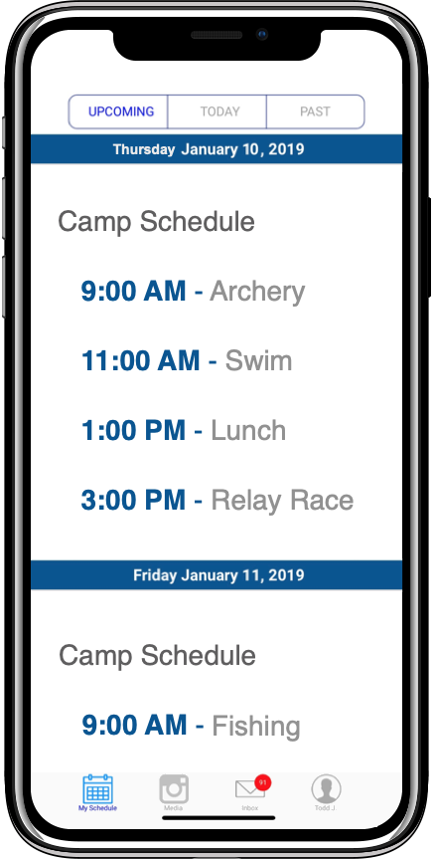
Camp – Resident, day, sports
Manage Documents & Camper Information Electronically
Create Schedules & Share on the Mobile App
Share Messages, Updates & Pictures with Parents
Camp YMCA
Camp YMCA
Dear Jill,
The following is required for camp participation
Camp Director Capone shared Week 1 Pics
Health History
Emergency Contacts
Water Park Waiver
Camp Director Capone posted a message
Visit the Parent Center to Provide the Requested Info:
Visit Parent Center
Notes:
Ben to Cover Sports

Slide 10
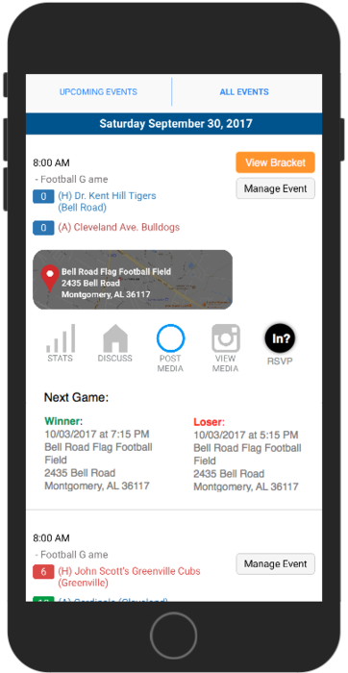
Mobile App
Parents & Participants
View Individual & Family Schedules
Communicate with Coaches
Share Pictures, Videos
Coaches & Instructors
View Schedules and Rosters
Mass email and Text
Share Pictures, Videos
Sports & Program Directors
Record Scores and Statistics
Mass email and Text
Player Look Up Tool
Player Evaluations
Share Pictures, Videos
Notes:
Ben to Cover Sports

Slide 11
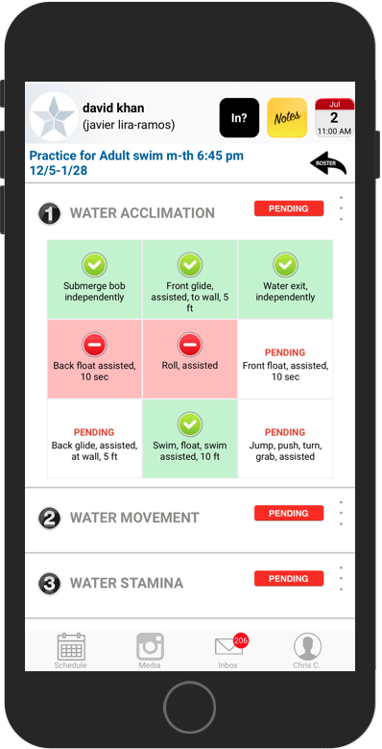
Mobile App - Swim
Aquatics Directors & Swim Instructors
Sign Swimmers into Classes
Evaluate Swimmers and Advance Them to the Next Level
Mass email and Text
Record Notes
Manage Substitutes
Benefits
Pre-loaded with the new YUSA swim curriculum
Significant labor and printing cost reductions
Participants’ history carries through to the next session.
Notes:
Lindsay to cover Swim

Slide 12
Benefits to the y team
Department / Personnel | Features & Benefits
Sports Directors | Bridge the Communication Gap between Coaches and Parents while Experiencing the Highest Levels of Productivity
Aquatics Directors | Reduce or Eliminate Paperwork, Save Hundreds of Hours Recording Evaluations, and Seamlessly Communicate YUSA Swim Curriculum Updates to Parents
Marketing | Ensure Brand Compliance for All Program Communication while increasing Program Participant to Facility Member Conversion Rates
Member Services | Instantly Provide Schedule and Program Information to Anxious Members and Participants through the Front Desk Virtual Assistant
CTO / IT | Vendor Consolidation
HR / Risk Department | Collaborate with Program Directors and Ensure Compliance While More Easily Onboarding Volunteers and Coaches
Notes:
Kevin to Cover

Slide 13
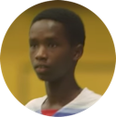
National sports & Aquatic portal
Portal
Sponsorship &
YMCA Messaging
Transformation
Patrick’s Story
Notes:
PlayerSpace will conduct Live Demo
Local Y Testimonial
Find a Y
Advertising & YMCA Messaging
Impact Stories
Portal = Still in Development
Geo-location
State, Regional, National Tournaments
Promote Leagues and Programs
Stream Events
Donation Button
Advertising
Cause Driven
Upsell Programs, Convert Parents to Membership (Ex. 70% of sports participants are not facility members, platform will provide marcom opportunities)
Paid
Data
Measure Demographic of Participants vs. Community
What’s Working Where

Slide 14
What’s Next for YMCAsports?
Navigational Menu Item Change to Separate Sports, Swim, Camp, Gymnastics, and Coaches & Volunteers
Media of the Week! Players, Swimmers, Gymnasts, Campers, and Volunteers
Stories of the Week!
Program Director and Volunteer Spotlight!
National and Local Sponsorship Programs
Performance Tracking and Conversion to Registration
Notes:
Lindsay to cover Swim

Slide 15
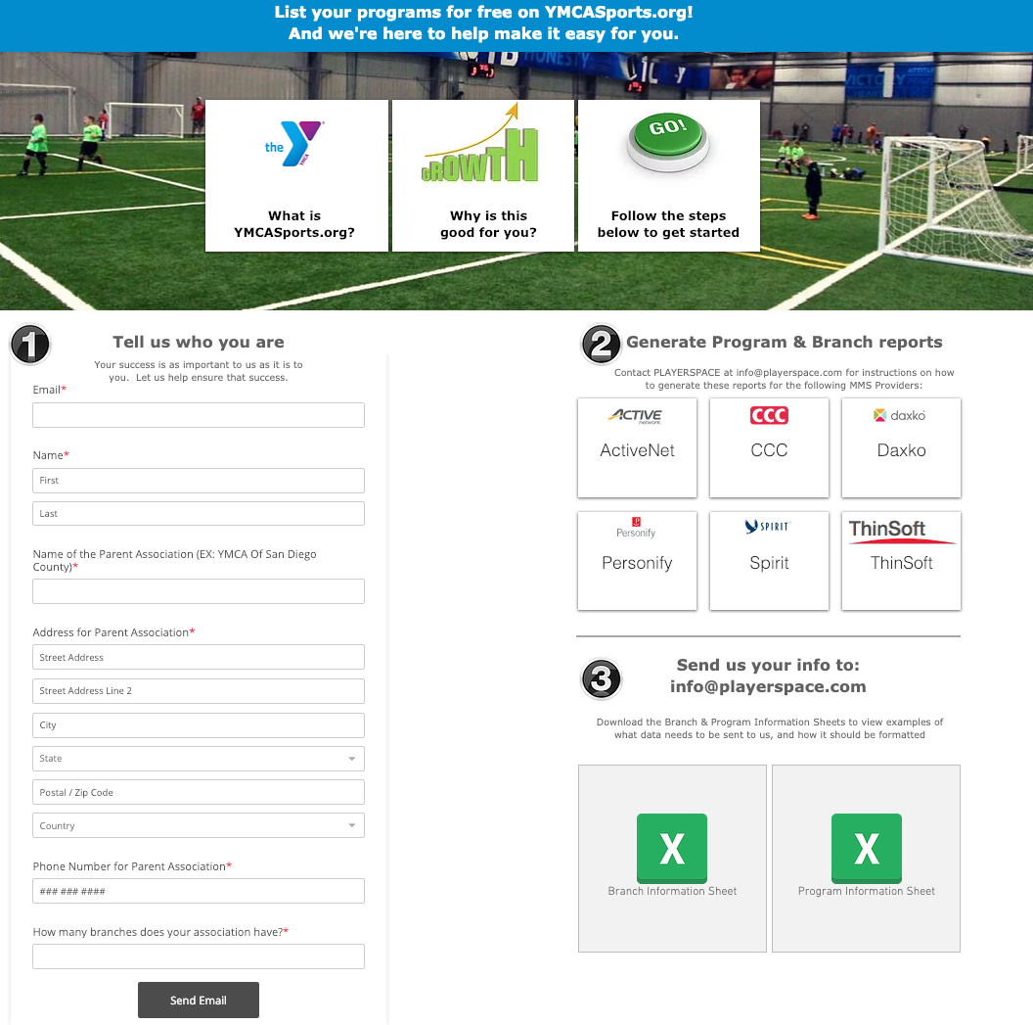
Program Data upload for all Ys

Slide 16
questions
Notes:
John to Facilitate

Slide 17
Thank You
John Atwater
Senior Director, Y-Movement Solutions and Services
YMCA OF THE USA
312 291 4088
john.atwater@ymca.net
Lindsay Mondick
Senior Manager-Aquatics
YMCA OF THE USA
312 917 4016
aquatics@ymca.net
PlayerSpace
Chris Capone
VP Customer Operations
516 425 3560
c.capone@playerspace.com
Notes:
John to Cover

